Slide 1


Strategic Partnership Unveiled: Navigating Growth, IPO Success, and Big Data Excellence with Social Buzz

Slide 2


Today's agenda
Project recap
Problem
The Analytics team
Process
Insights
Summary

Slide 3

Social Buzz is a fast growing technology unicorn
that need to adapt quickly to its globle scale.
Accenture has began a 3 month POC focusing
on these task :
An audit of Social Buzz’s
big data practice
Recommendations for a successful IPO
Analysis to find Social Buzz’s top 5 most
popular categories of content
Project Recap

Slide 4

Over 100000 posts per day
36,500,000 pieces of content per year!
But how to capitalized on it when there is so much?
Analysis to find Social Buzz’s top 5 most popular
categories of cntent.
Problem

Slide 5



Pratiksha Deshmukh
Data analyst
The Analytics team
Marcus Rompton
Senior Principle
Andrew Fleming
Chief Technical Architect

Slide 6
Data understanding
Process
1
Data Cleaning
2
Data Modelling
3
4
Data Analysis
Uncover Insights
5

Slide 7

Insights
16 UNIQUE CATEGORIES
1897 REACTIONS TO “ANIMAL”
POSTS
JANUARY MONTHS WITH MOST POSTS

Slide 8
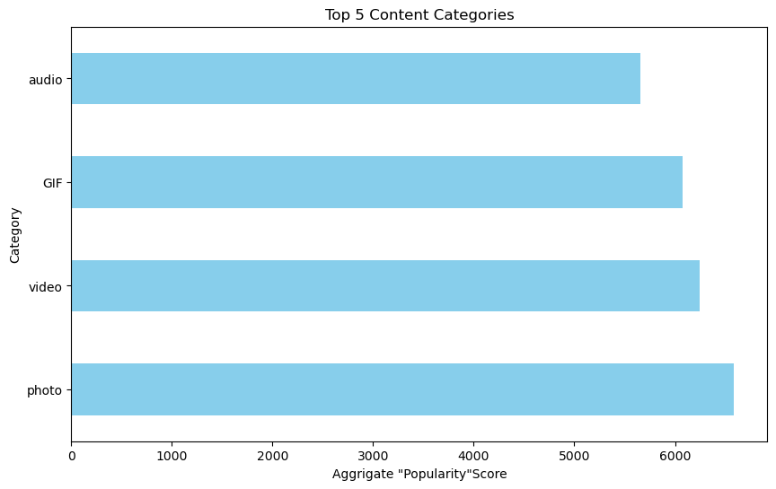

Slide 9
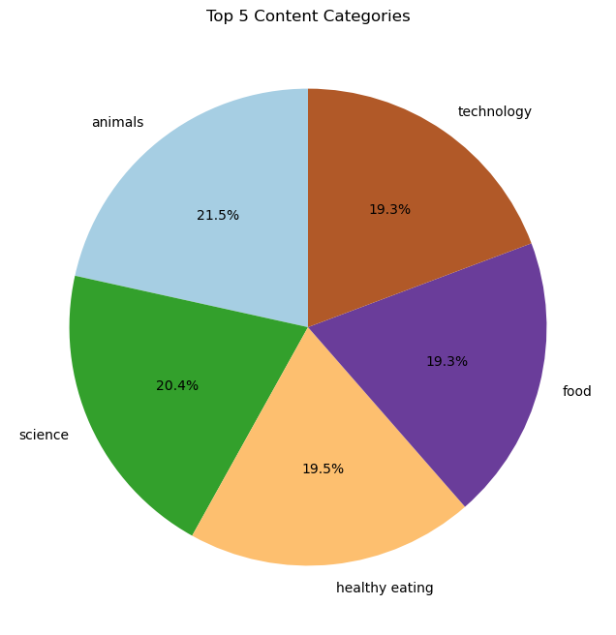

Slide 10

ANALYSIS Animal and science are the two most
popular categories of
content,showing that people enjoy
“real-life” and “factual”content the most INSIGHT Food is a commen theme with the
top 5categories with “Eating” ranking the
audience within your user base.
You could use this insight to create
a campaign and work with healthy eating
brands to boost user engagement NEXT STEPS This ad-hoc analysis is insightful,but it’s time
to take this analysis
into large scale production for real-time
understanding of your business.
We can show you how todo this
Summary

Slide 11
Thank you!
ANY QUESTIONS?

